Slide 1
Root Interval Schemas in Rock Music
Jacob Gran, David John Baker
Louisiana State University
South Central Society for Music Theory, March 23-24, 2018
University of Southern Mississippi, Hattiesburg MS

Slide 2
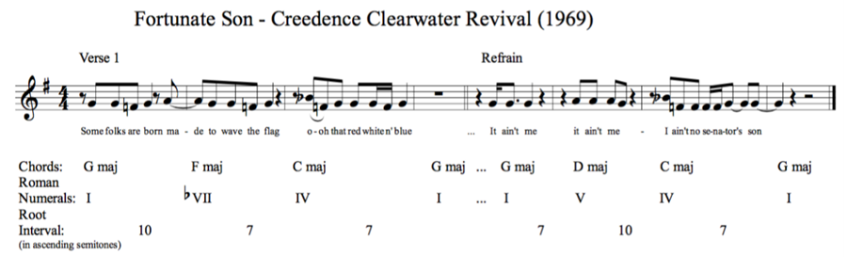
Fortunate Son (1969) Creedence Clearwater Revival

Slide 3
Fortunate Son (1969) Creedence Clearwater Revival

Slide 4

Fortunate Son (1969) Creedence Clearwater Revival

Slide 5
Root Interval Schemas in Rock Music
Jacob Gran, David John Baker
Louisiana State University
South Central Society for Music Theory, March 23-24, 2018
University of Southern Mississippi, Hattiesburg MS

Slide 6
Fortunate Son (1969) Creedence Clearwater Revival

Slide 7
Fortunate Son (1969) Creedence Clearwater Revival

Slide 8
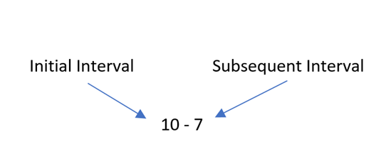
Root Interval Schema

Slide 9
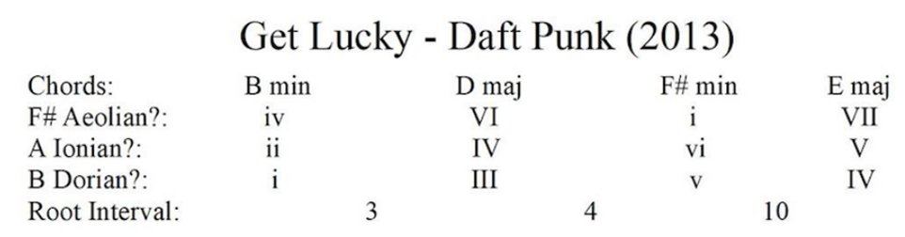
Get Lucky (2013) Daft Punk featuring Pharrell Williams

Slide 10
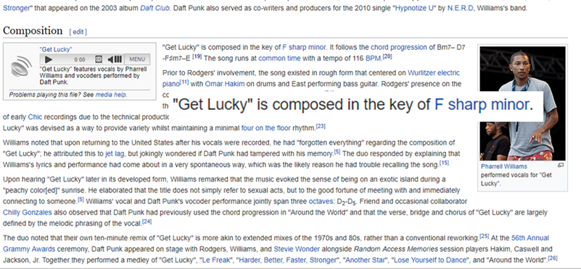

Slide 11
Get Lucky (2013) Daft Punk featuring Pharrell Williams

Slide 12
Get Lucky (2013) Daft Punk featuring Pharrell Williams

Slide 13
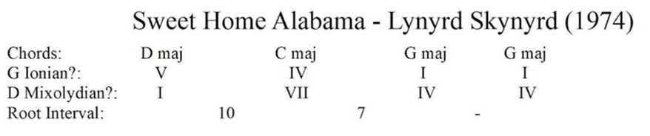
Sweet Home Alabama (1974) Lynyrd Skynyrd

Slide 14
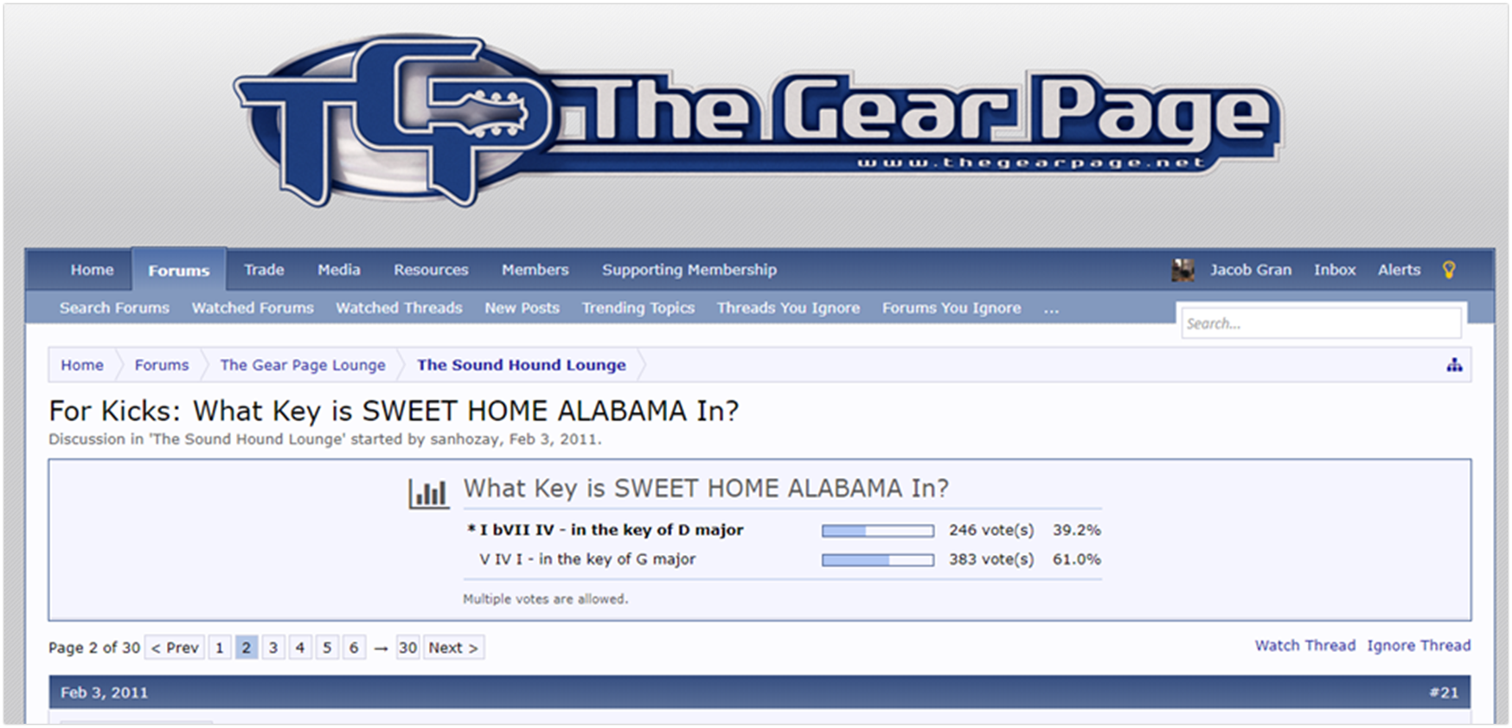

Slide 15
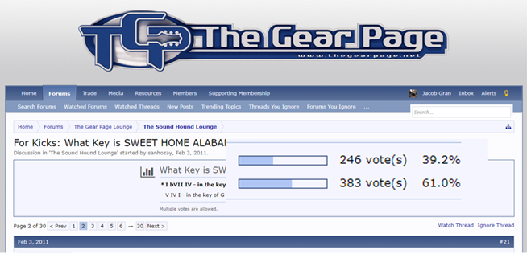

Slide 16
Sweet Home Alabama (1974) Lynyrd Skynyrd

Slide 17
Root Interval Schemas in Rock Music
Jacob Gran, David John Baker
Louisiana State University
South Central Society for Music Theory, March 23-24, 2018
University of Southern Mississippi, Hattiesburg MS

Slide 18
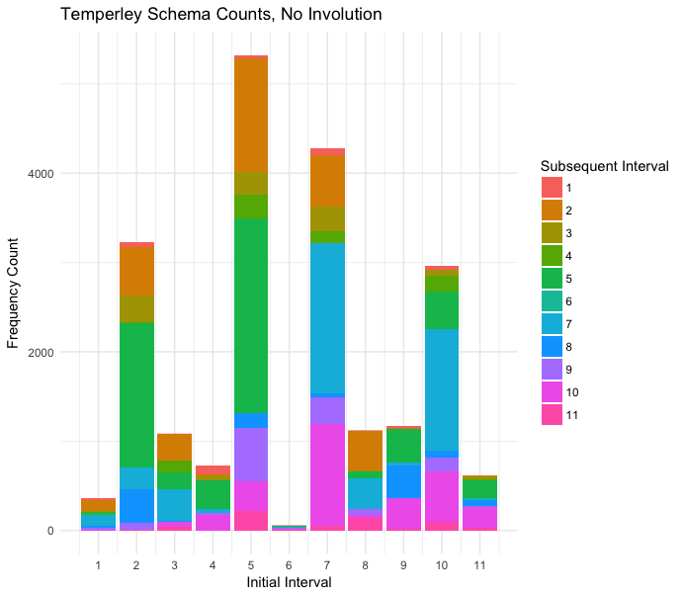

Slide 19
Most Frequent Schemas
Schema | Count
5-5 | 2179
7-7 | 1682
2-5 | 1618
10-7 | 1365
5-2 | 1272
7-10 | 1148
5-9 | 595
7-2 | 573
10-10 | 565

Slide 20
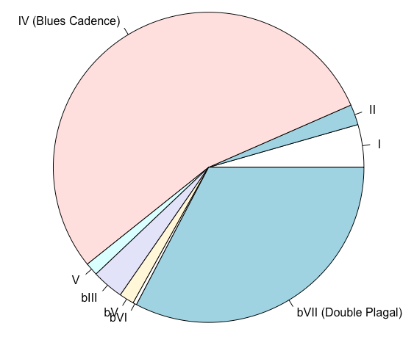
10-7 Breakdown

Slide 22
Most Frequent Schemas
Schema | Count
5-5 | 2179
7-7 | 1682
2-5 | 1618
10-7 | 1365
5-2 | 1272
7-10 | 1148
5-9 | 595
7-2 | 573
10-10 | 565

Slide 23
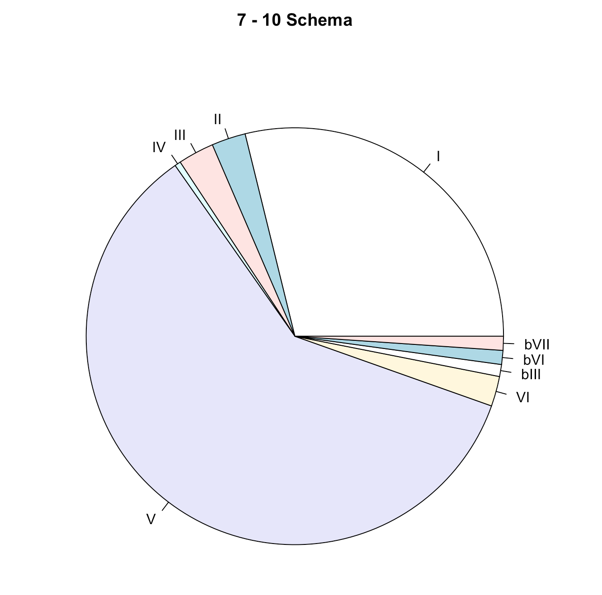
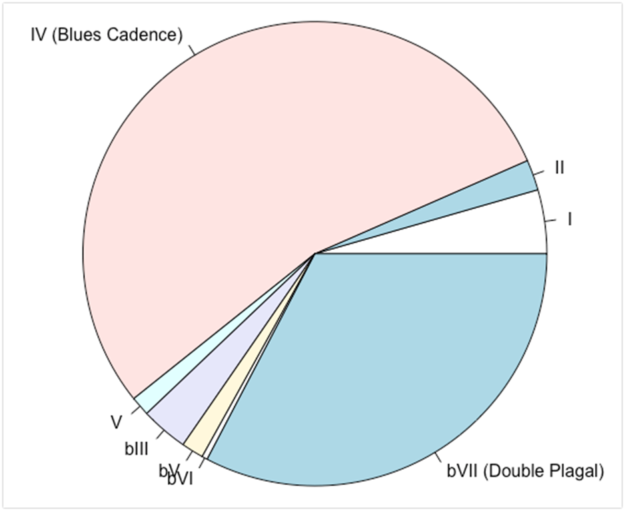
7-10 vs 10-7 Comparison

Slide 24
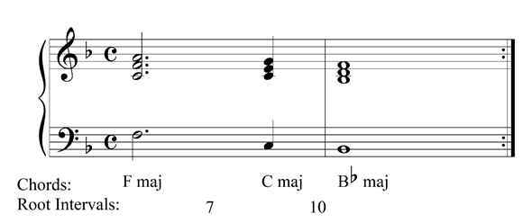
Baba O’Riley (1971) The Who

Slide 25
Most Frequent Schemas
Schema | Count
[2,5] | 2890
[7,10] | 2513
5-5 | 2179
7-7 | 1682
5-9 | 595
7-2 | 573
10-10 | 565

Slide 26
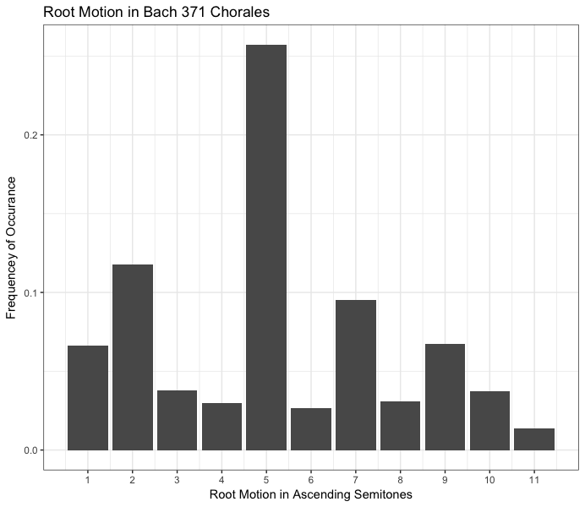
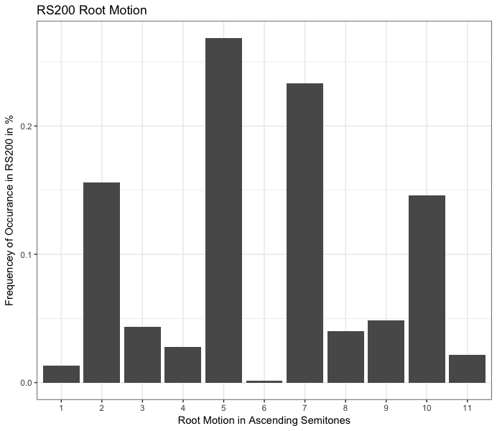
Bach vs Rock

Slide 27
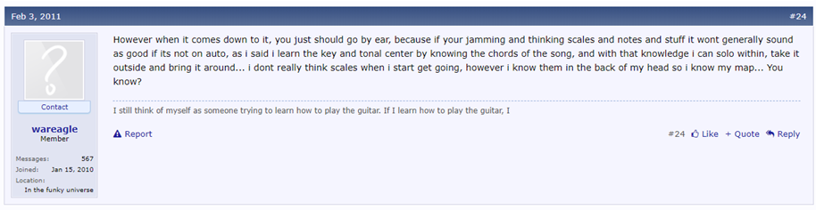

Slide 28
Root Interval Schemas in Rock Music
Jacob Gran, David John Baker
Louisiana State University
South Central Society for Music Theory, March 23-24, 2018
University of Southern Mississippi, Hattiesburg MS

Slide 29
Selected Bibliography
Acevedo, Stefanie. 2018. “Formal and Harmonic Schemata of Popular Music: An Empirical Investigation of Analytical Patterns and their Mental Representations.” Unpublished doctoral dissertation, Yale University.
Biamonte, Nicole. 2010. “Triadic Modal and Pentatonic Patterns in Rock Music.” Music Theory Spectrum 32 no. 2 (Fall): 95-110.
Burgoyne, J.A., Wild, J., and Fujinaga, I. 2011. “An Expert Ground-Truth Set for Audio Chord Recognition and Music Analysis.” ISMIR 2011, 633-638.
De Clercq, Trevor, and David Temperley. 2011. “A Corpus Analysis of Rock Harmony.” Popular Music 30 no. 1: 47- 70.
Hughes, Bryn. 2011. “Harmonic Expectation in Twelve-Bar Blues Progressions.” PhD diss., Florida State University.
Nobile, Drew. 2016. “Harmonic Function in Rock Music: A Syntactical Approach.” Journal of Music Theory 60 no. 2: 149-180.
Meyer, Leonard B. 1989. Style and Music: Theory, History, and Ideology. Philadelphia: University of Pennsylvania Press.
Saffran, J.R., et al. 1999. “Statistical Learning of Tone Sequences by Human Infants and Adults.” Cognition 70 no. 1: 27-52.
Stephenson, Ken. 2002. What to Listen for in Rock: A Stylistic Analysis. New Haven, CT: Yale University Press.

